Slide 1
Pedel
Pro
RIDE WITH PASSION, CONQUER WITH CONFIDENCE

Slide 2
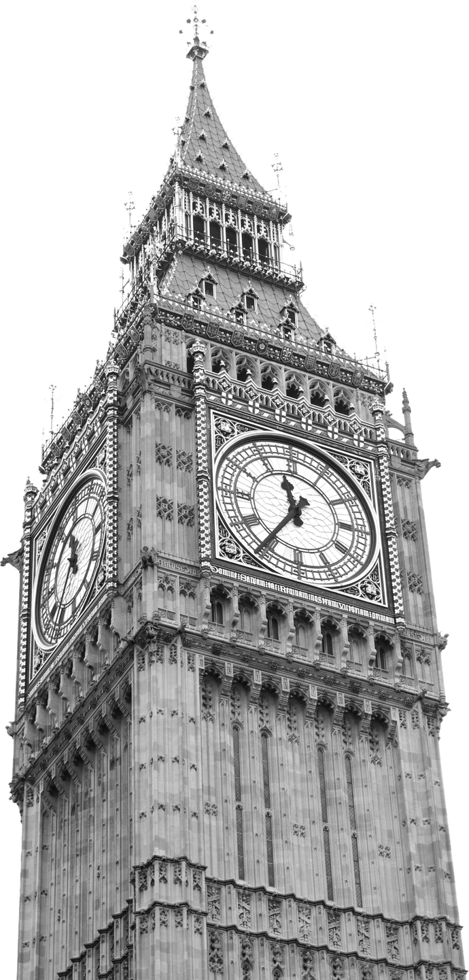

Backgound
PedalPro is a premier bike store that specializes in providing high-quality bicycles and cycling gear to enthusiasts and casual riders alike. Established with a passion for cycling and a commitment to excellence, PedalPro aims to become the go-to destination for all things cycling.

Slide 3









Dataset
CUSTOMERS
CATEGORIES
ORDERS
ORDER ITEMS
STAFFS
STORES
PRODUCTS
STOCKS
BRANDS

Slide 4
Business Request’s
5 key Business Requests
TOP 5 CUSTOMERS BY NUMBER OF ORDERS
TOTAL REVENUE GENERATED BY EACH STORES
TOTAL SALES FOR TOP 5 PRODUCT

Slide 5
Business Request’s
5 key Business Requests
TOP 5 CUSTOMERS BY MONEY SPEND
HIGHEST SALES VOLUMN IN 2018

Slide 6


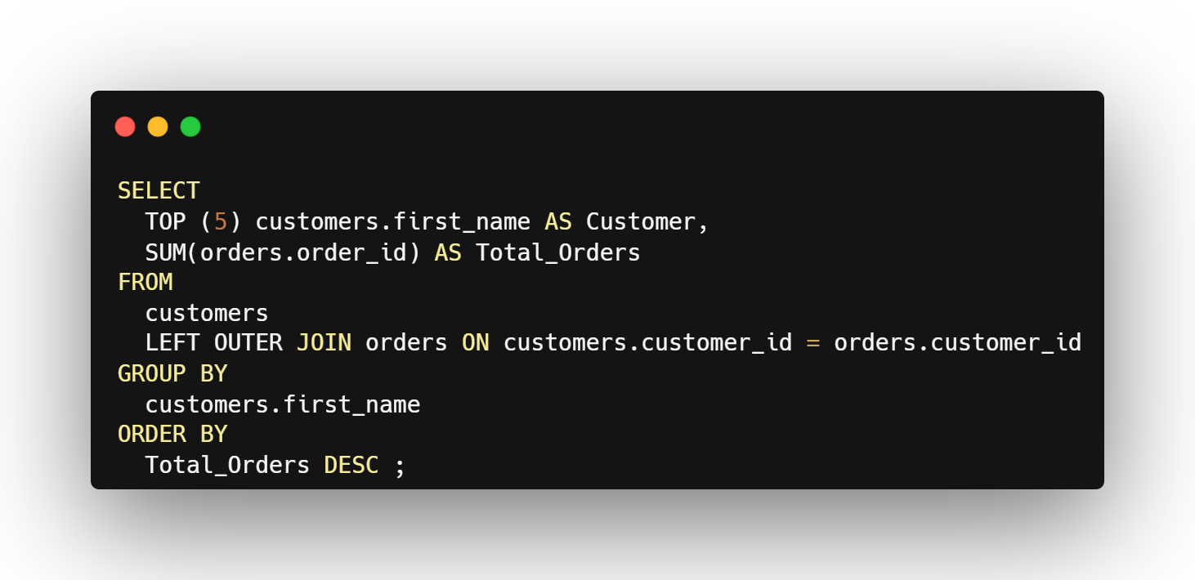
Top 5 Customers by number of orders

Slide 7

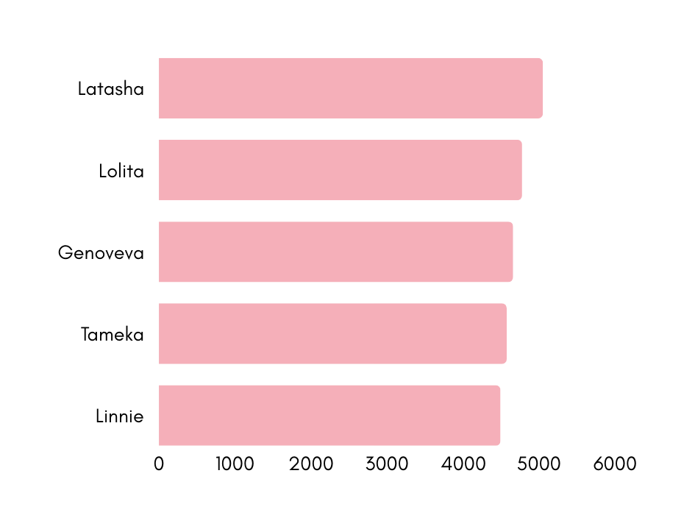
Top 5 Customers by number of orders
Here we can see that latasha having the most number of orders that is 5052

Slide 8
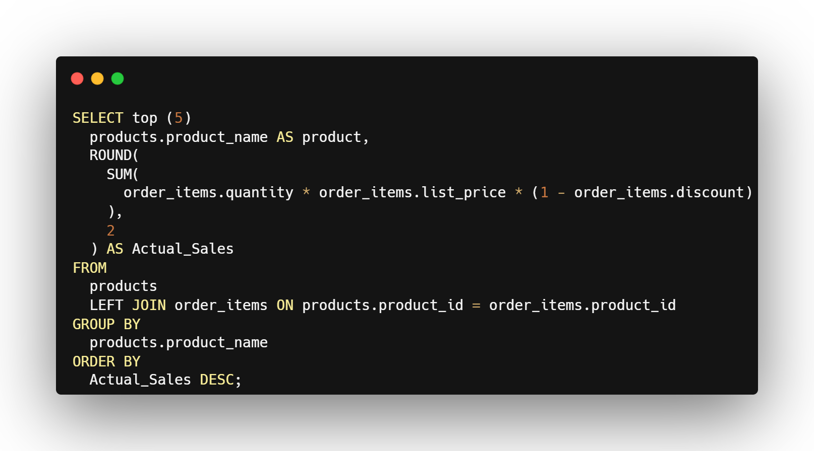
Total sales for Top 5 product

Slide 9

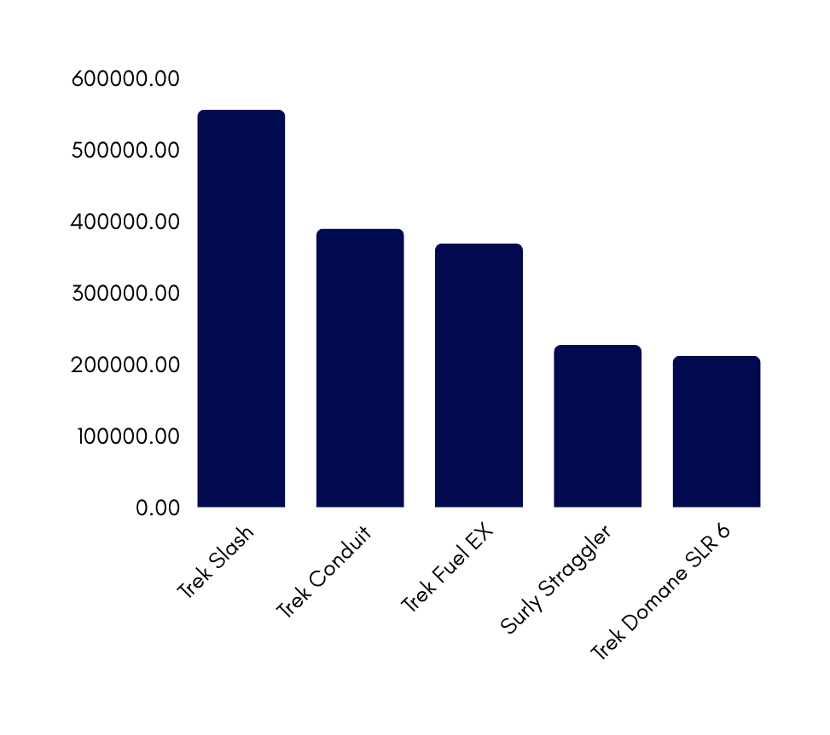
Total sales for Top 5 product
The highest selling product is Trek Slash with 555K Dollers

Slide 10
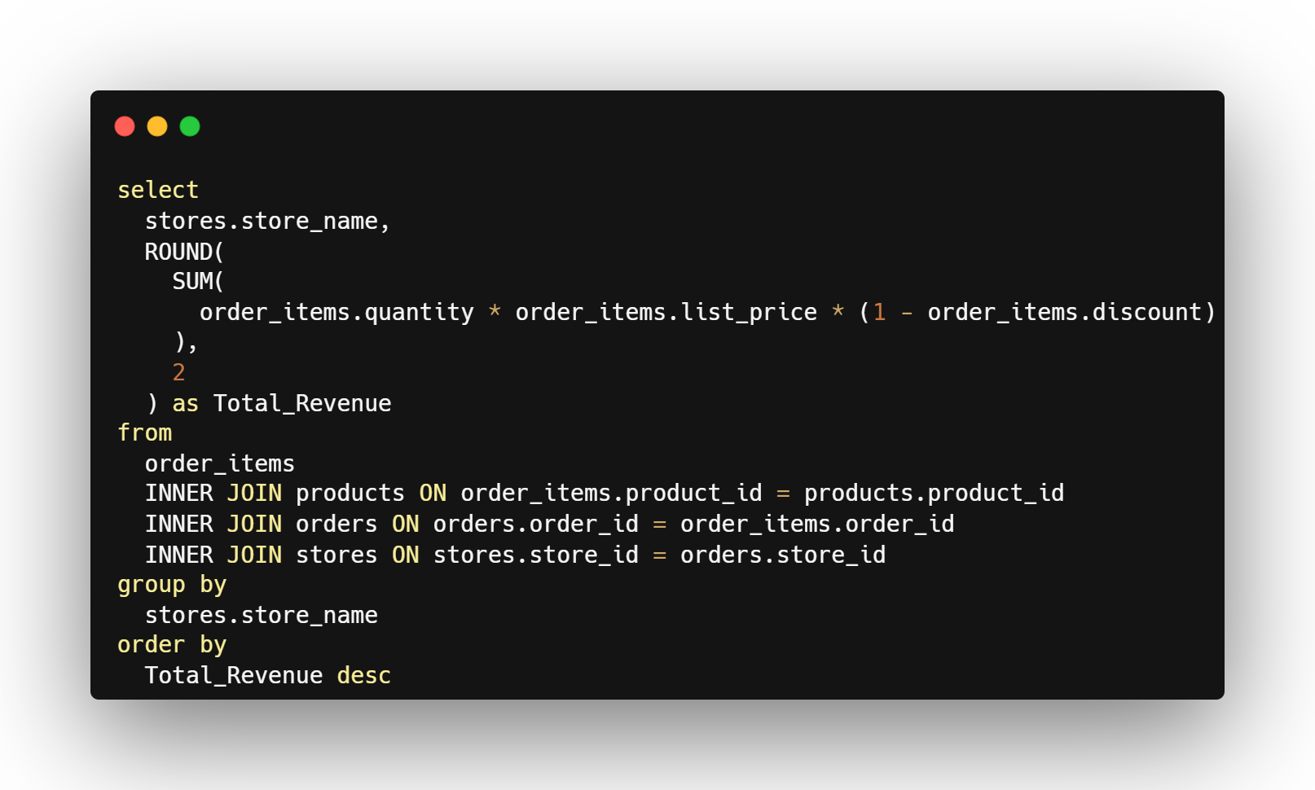
Total Revenue generated by each stores

Slide 11
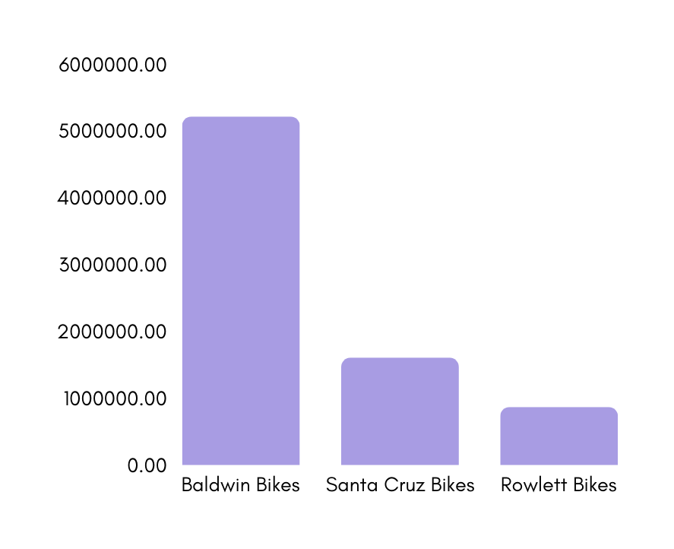
Total Revenue generated by each stores
Baldwin Store have the maximum revenue among other stores which is 521k Doller’s

Slide 12
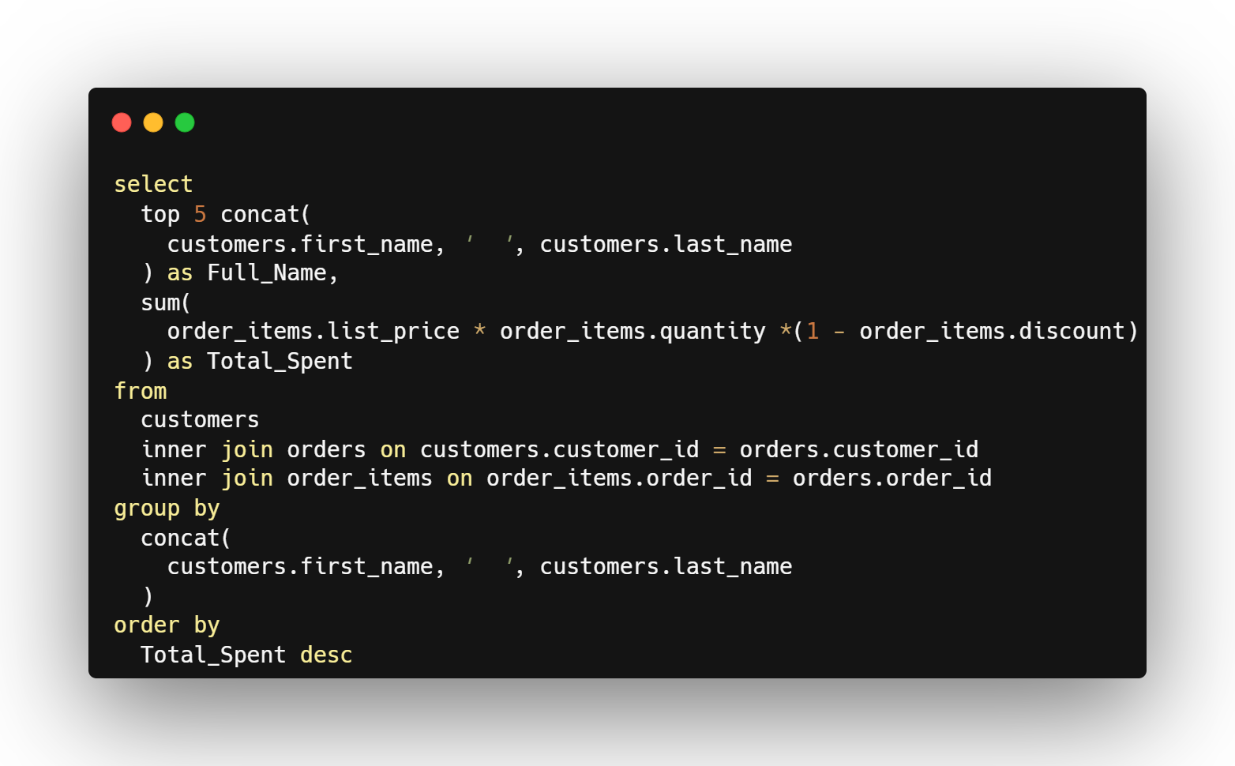
Top 5 Customers by Money Spend

Slide 13

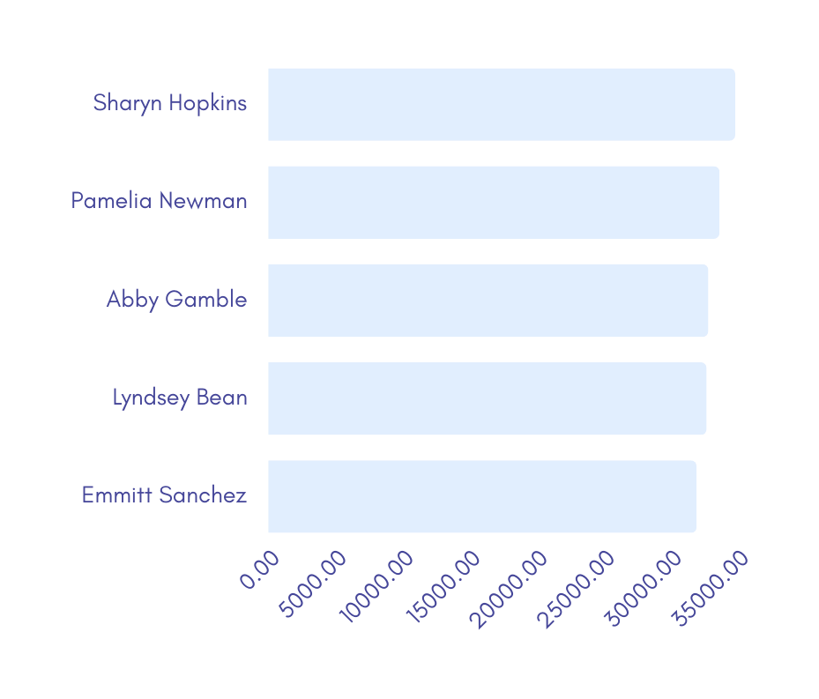
Top 5 Customers by Money Spend
Sharyn Hopkins is the name of the customer who spend the most amout of money which is 34k Doller’s

Slide 14
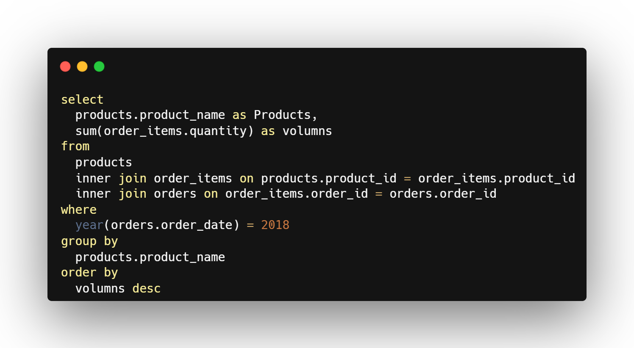
Highest sales volumn in 2018

Slide 15
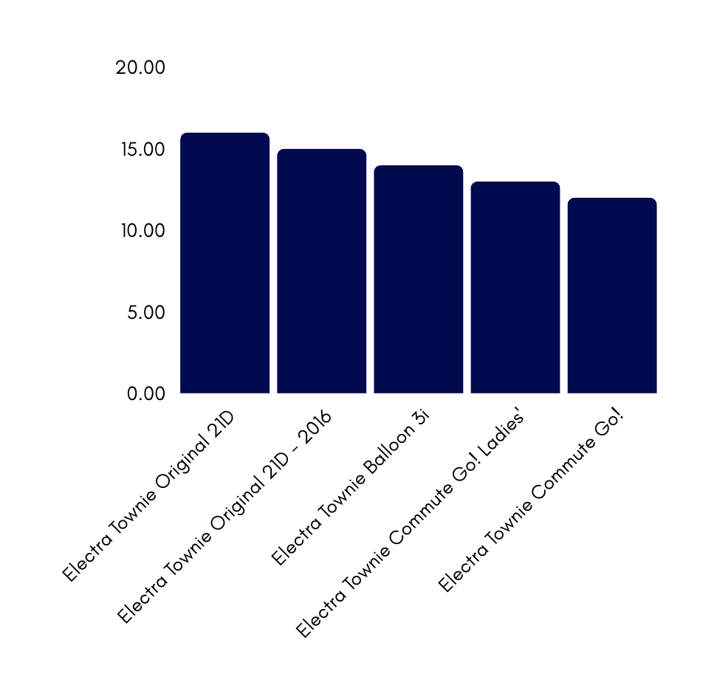
Highest sales volumn in 2018
Electra Townie Original 21D has the highest volume among’s other products

Slide 16



Products
Customers
Orders
Stores
Additional Analysis

Slide 17
Products

Slide 18

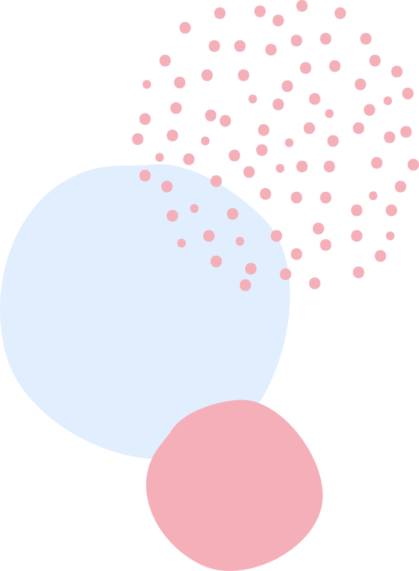
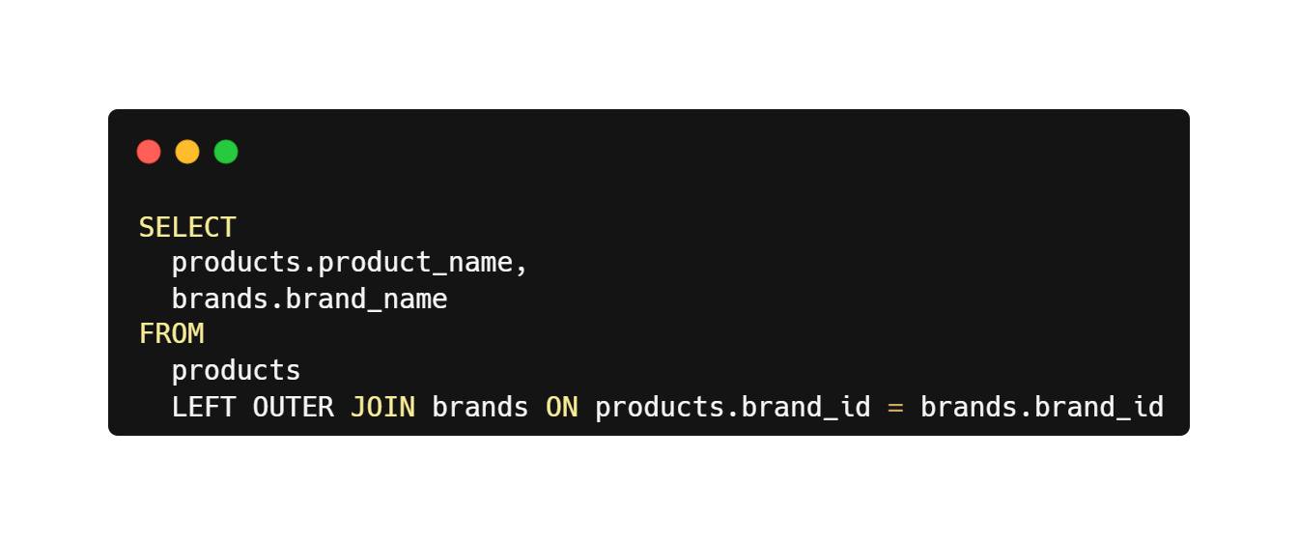
Total List Of Products

Slide 19
Products | Brands
Ritchey Timberwolf Frameset - 2016 | Ritchey
Surly Wednesday Frameset - 2016 | Surly
Trek Fuel EX 8 29 - 2016 | Trek
Heller Shagamaw Frame - 2016 | Heller
Surly Ice Cream Truck Frameset - 2016 | Trek
Total list of products
There are total of 291 Products

Slide 20
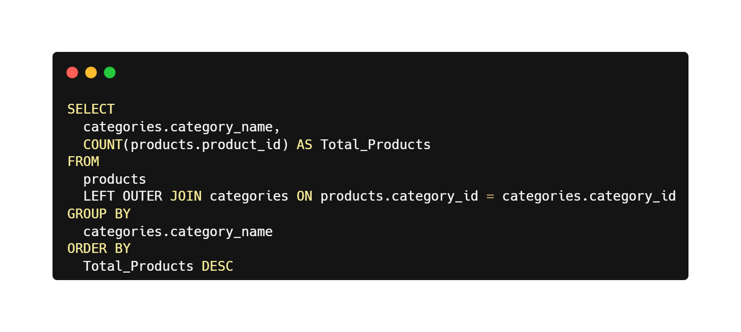
Number of products in each category

Slide 21
Categories | Number Of Products
Cruisers Bicycles | 70
Mountain Bikes | 60
Road Bikes | 60
Children Bicycles | 59
Comfort Bicycles | 30
Electric Bikes | 24
Cyclocross Bicycles | 10
Number of products in each category
There are total of 7 Categories and Cruisers Bicycles aare having the maximum number of products

Slide 22
Customers

Slide 23

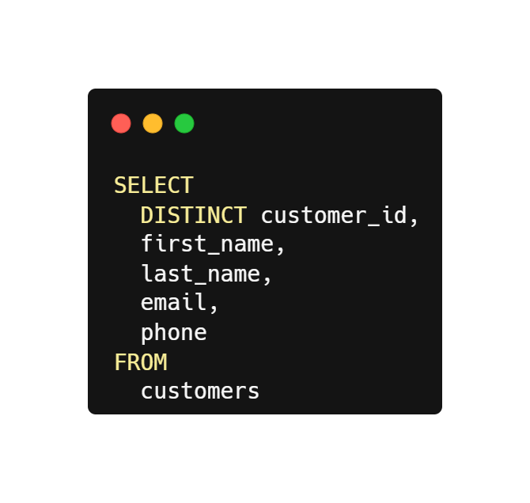
Customer details

Slide 24
1445
Customer
details
Unique customers
we have got 1445 unique customers

Slide 25
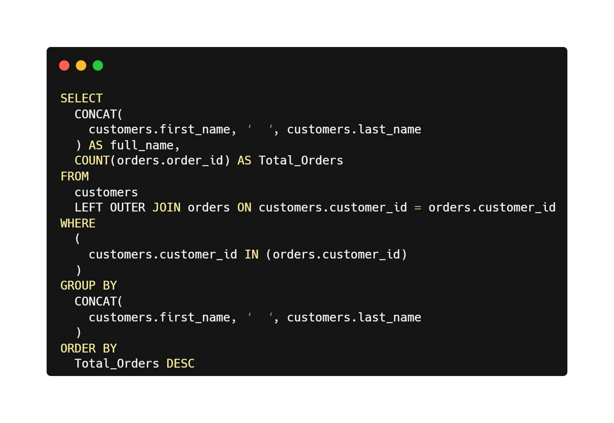
customers who have placed at least one order

Slide 26
1445
customers who have placed at least one order
Unique customers
All 1445 customers have order at least 1 time and the max number of order a single customer order is 3

Slide 27
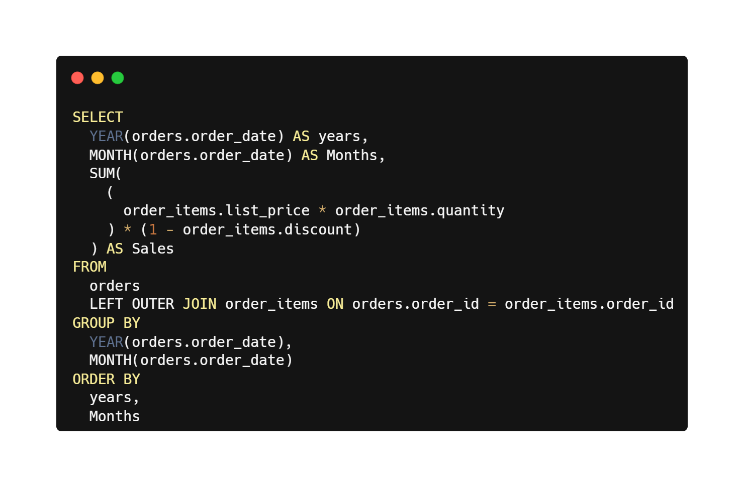
Total sales amount for each month

Slide 28
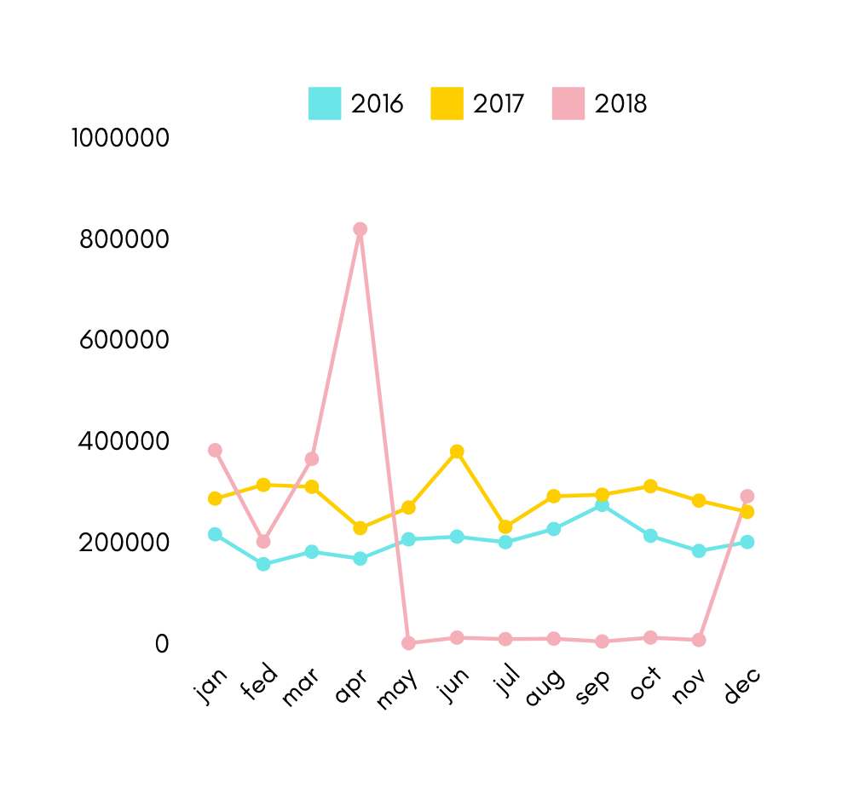
Total sales amount for each month
All 1445 customers have order at least 1 time and the max number of order a single customer order is 3

Slide 29
Orders

Slide 30
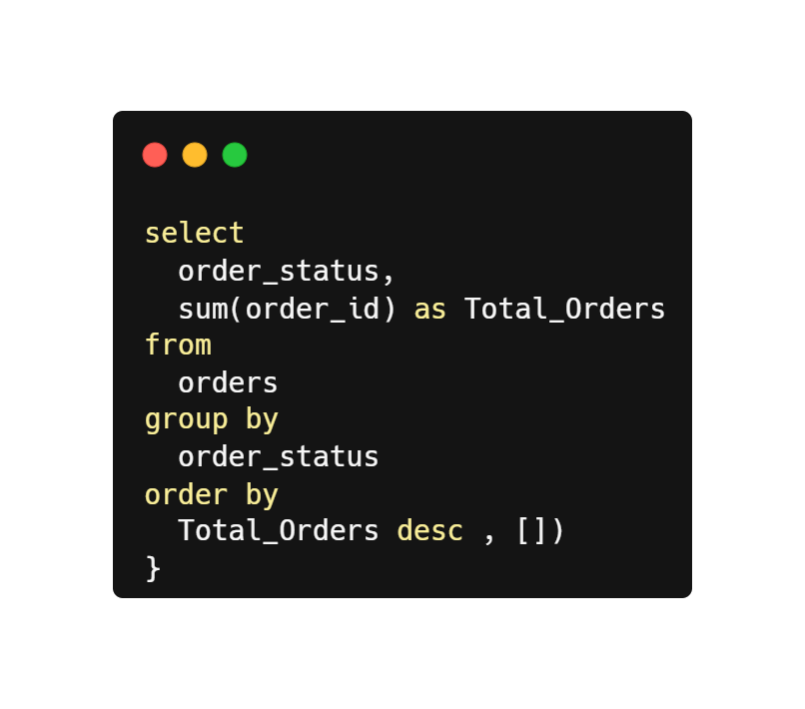
Number of orders for each order status

Slide 31
Order Status | Orders
4 | 1070297
2 | 96966
1 | 95659
3 | 41998
Number of orders for each order status
The order status 4 have the maximum number of orders

Slide 32
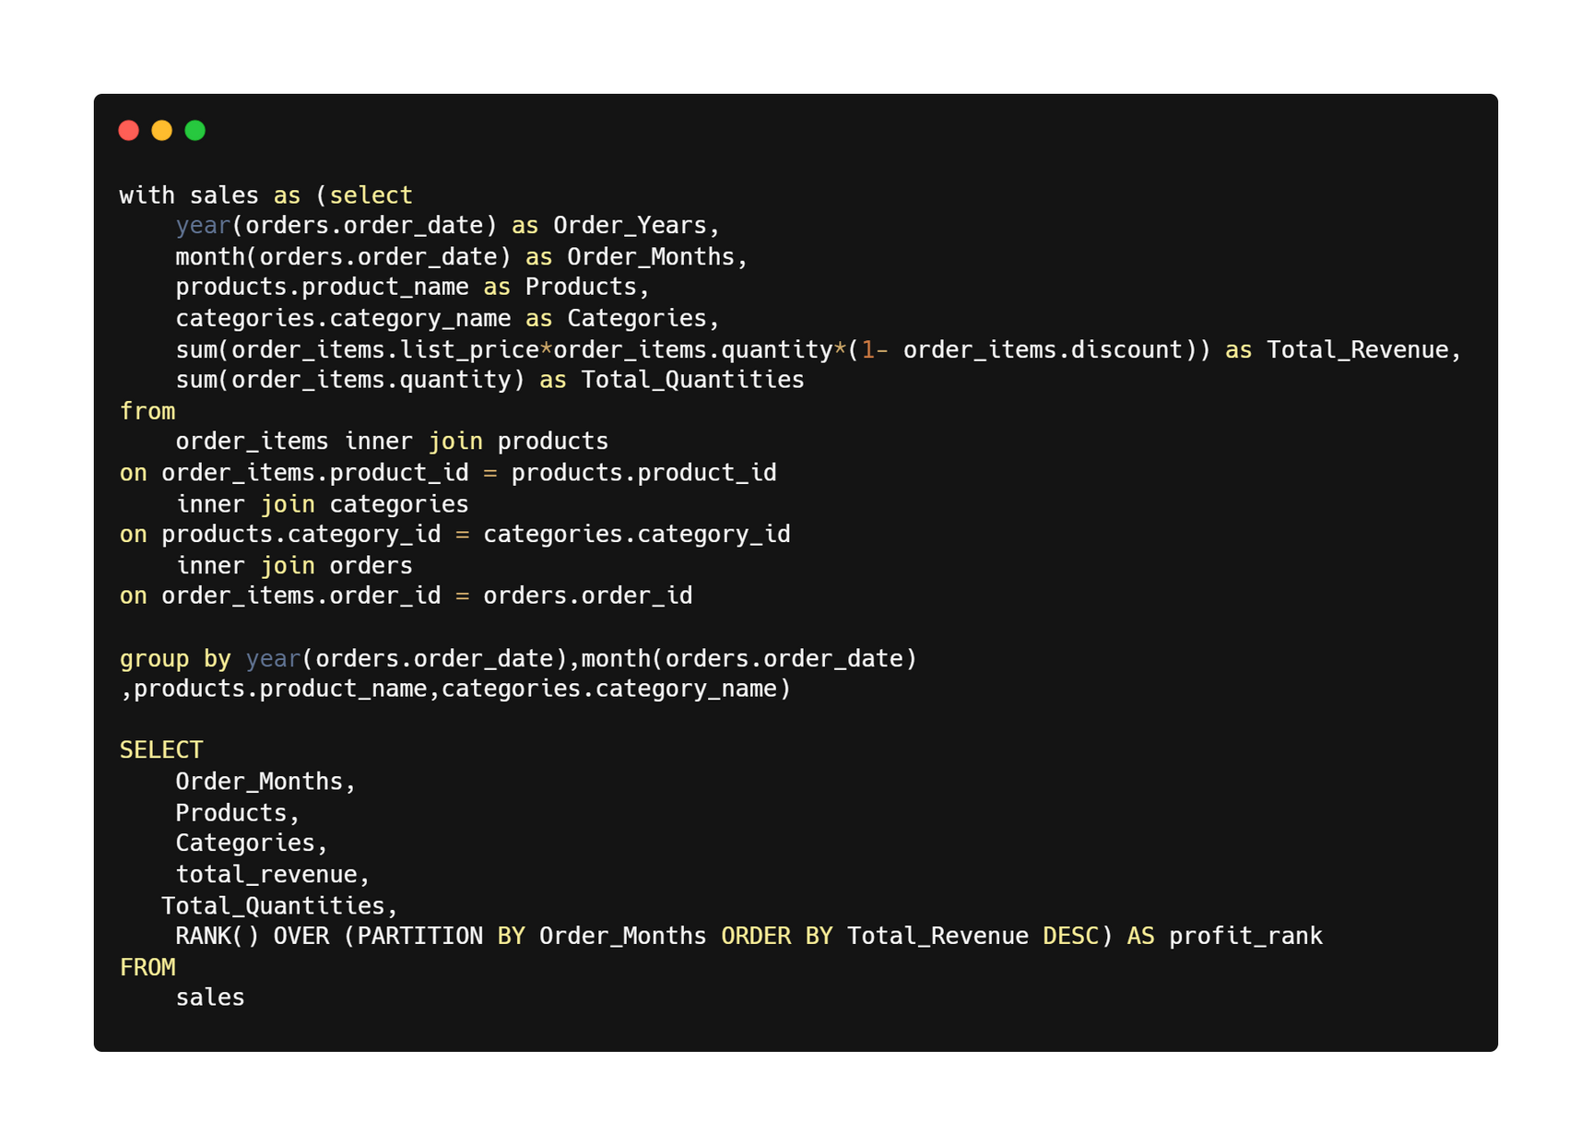
sales trends over time for our different bike models and categories

Slide 33
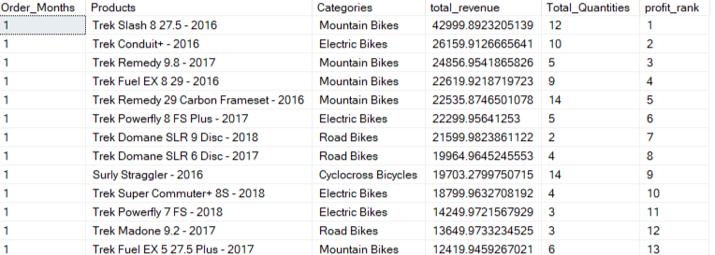
sales trends over time for our different bike models and categories
Rank 1 product with highest sales is from 1 month

Slide 34
stores

Slide 35
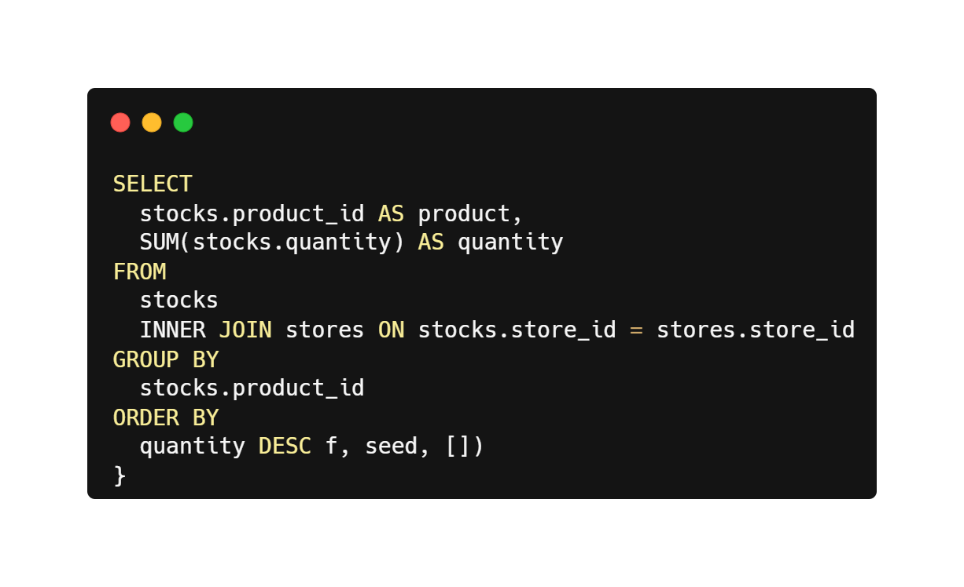
Total quantity of each product available in all stores

Slide 36
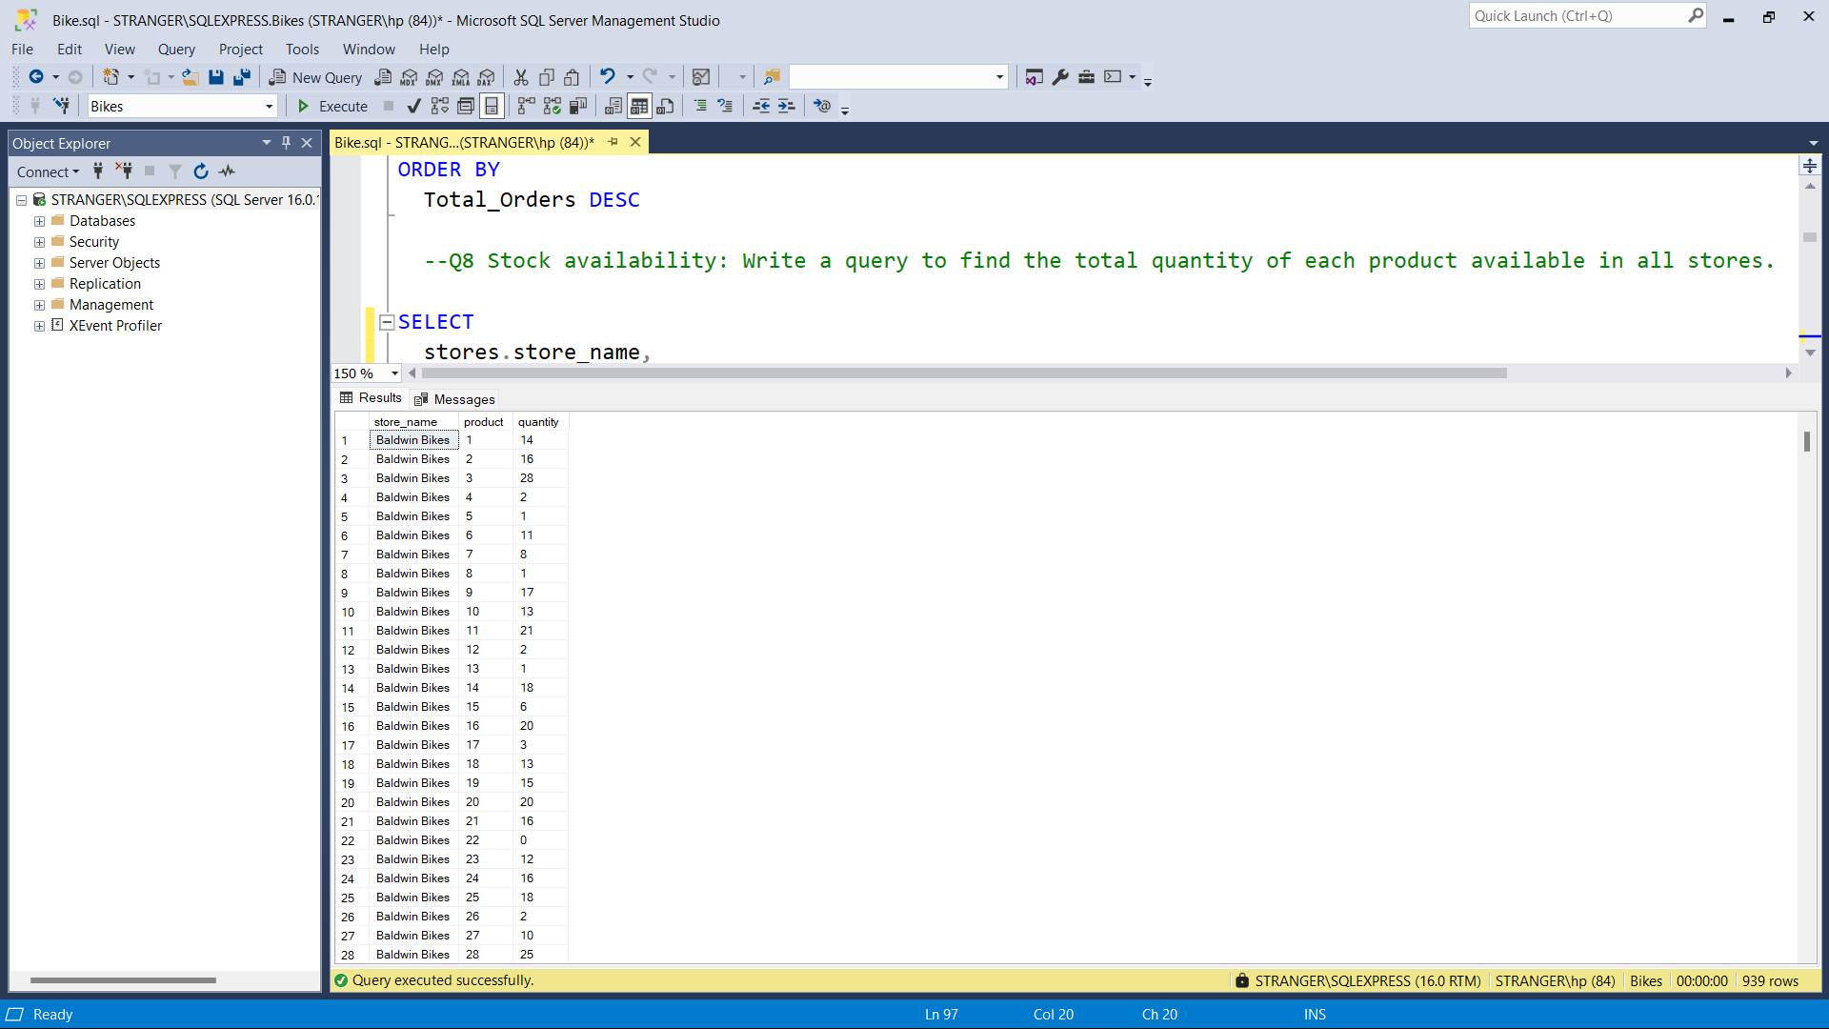
Total quantity of each product available in all stores

Slide 37
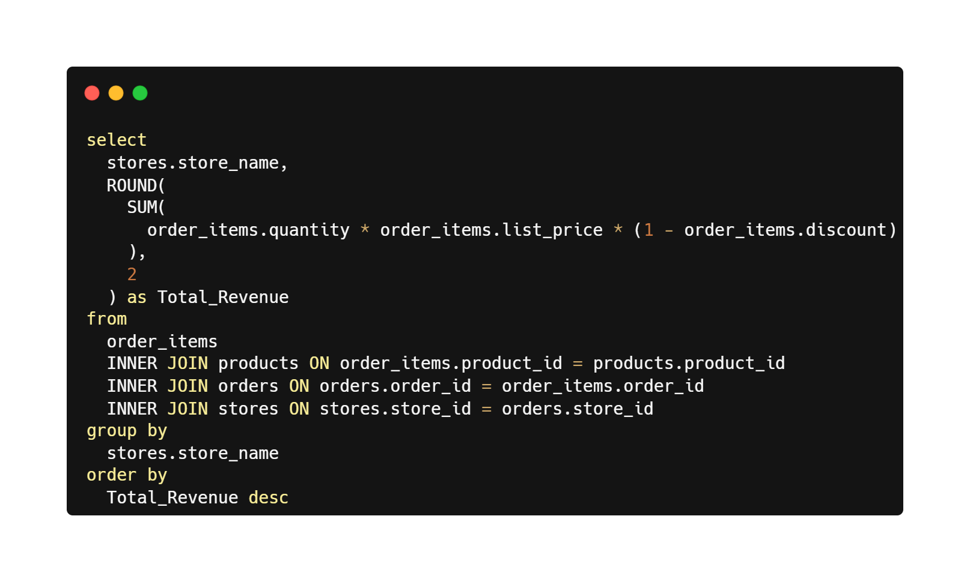
Total revenue generated by each store

Slide 38
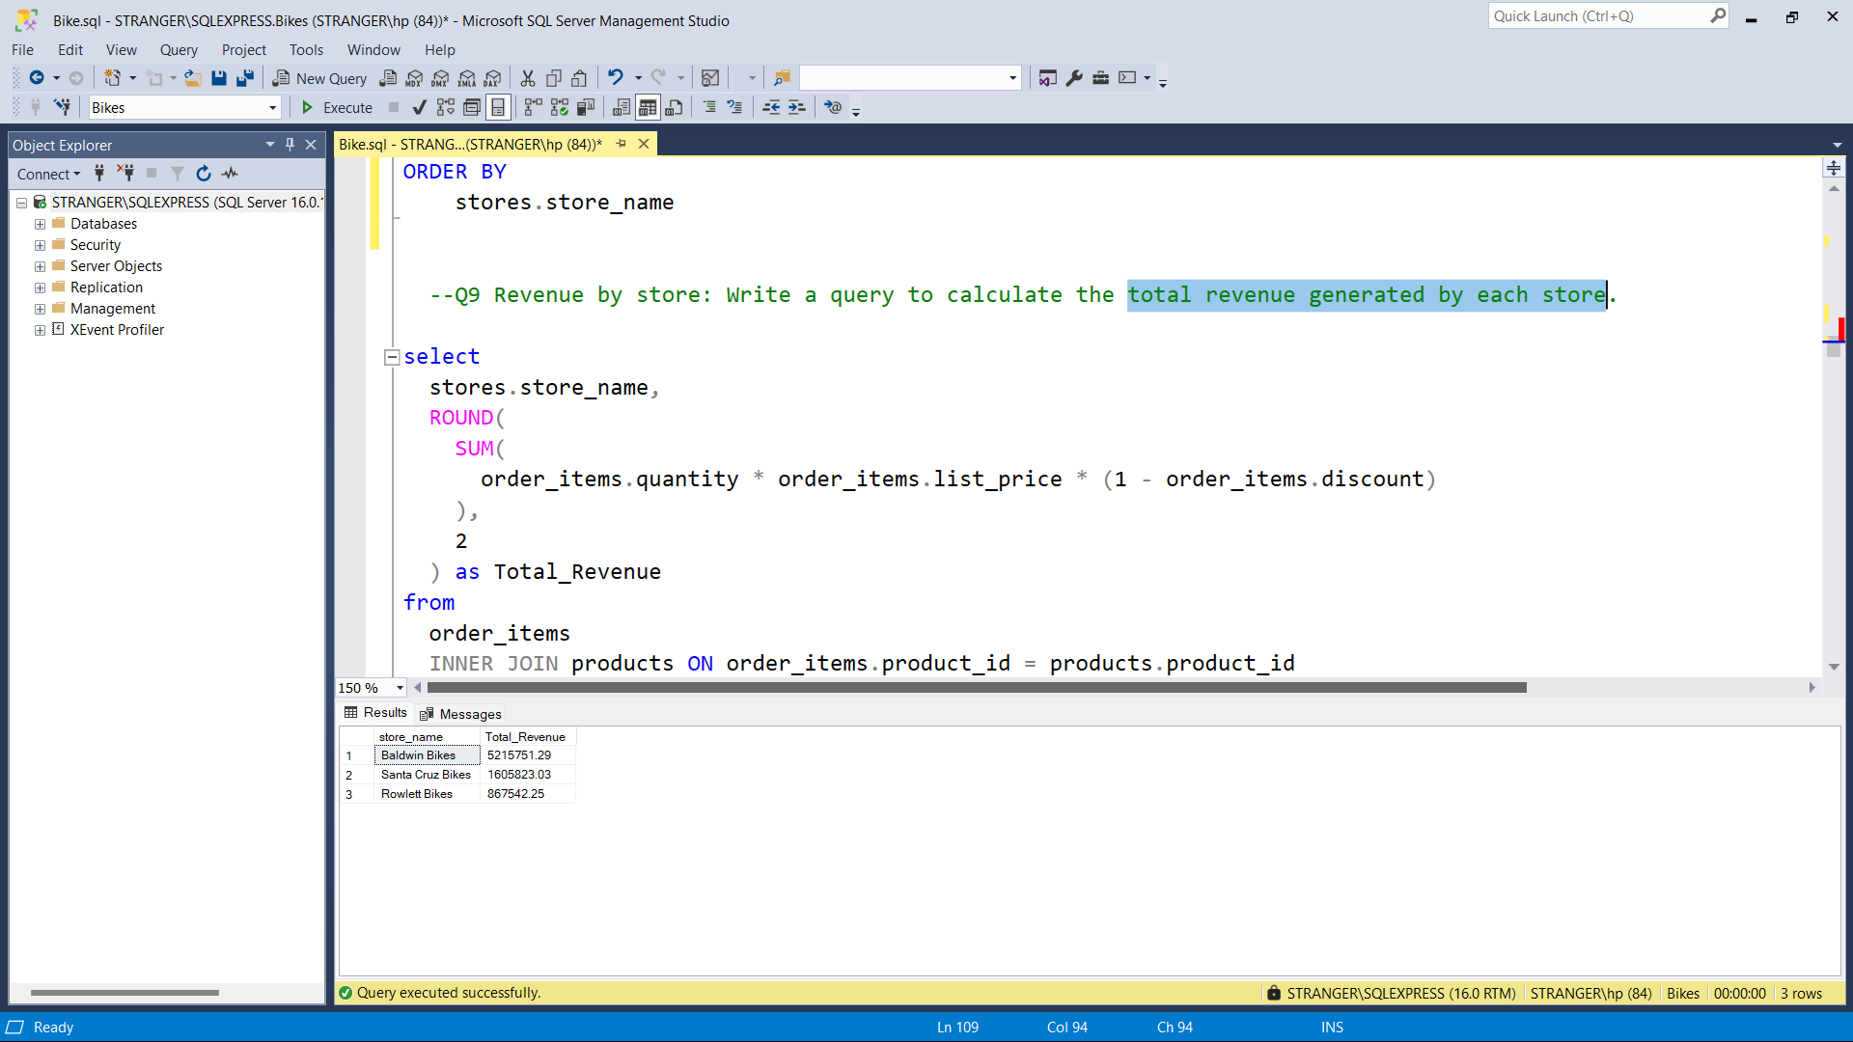
Total revenue generated by each store
The highest Revenue is generated by baldwin Bikes is 5M

Slide 39
Thank You

